Slide 1
Raspberry Pi and Photoelectric Sensors
Heon Soo Park, Robert Akinie

Slide 2
Project Overview
The overall project that this team is working on is our senior design project, which is the development of a self-sorting recycling system.
This project focuses on the utilization of photoelectric sensors.

Slide 3
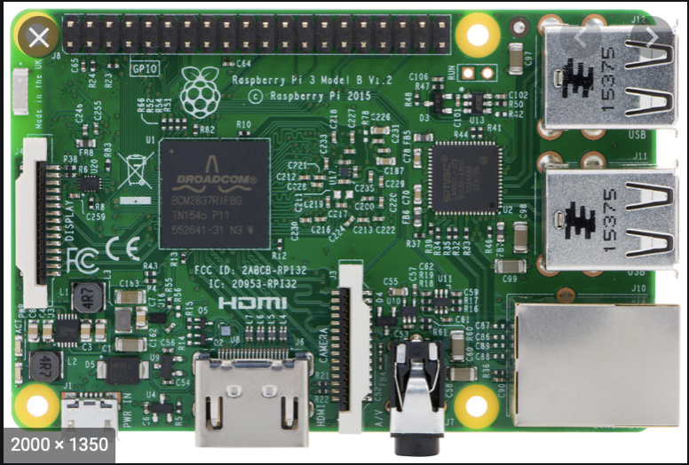
Raspberry Pi
Raspberry Pi 3
GPIO pins
Could be used for input and output
Uses 3.3V and 5V

Slide 4
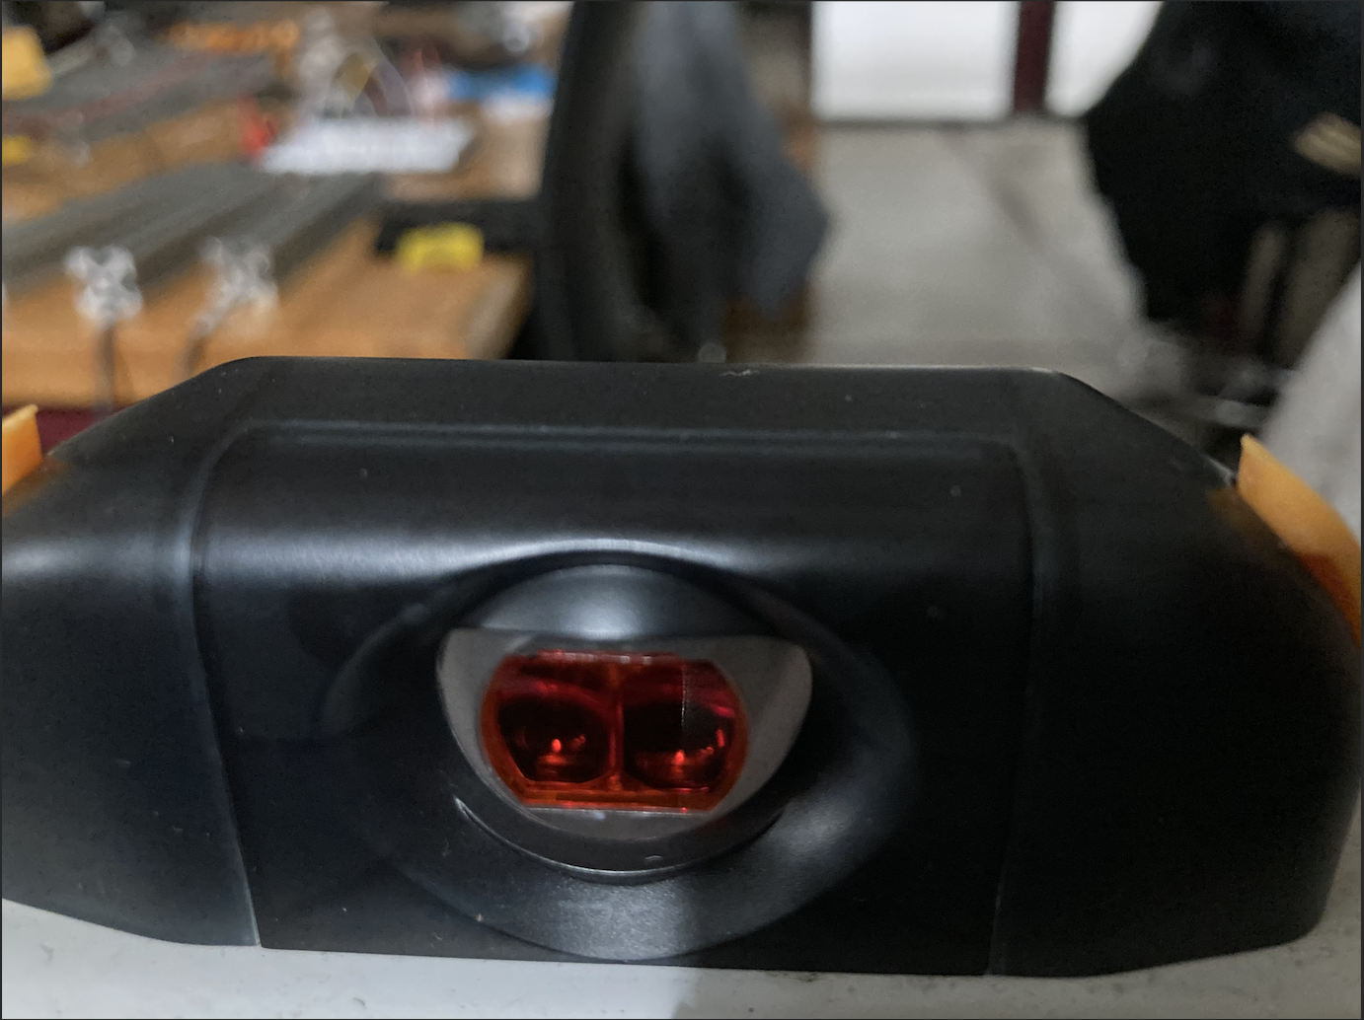
Photoelectric Sensor
Emits an infrared light off of a reflector and receives that emitted light off of the reflector. Output is triggered when the light gets blocked.
Uses a PNP system and a 4 pin pigtail

Slide 5
Goal:
Connect the photoelectric sensors to the Raspberry Pi GPIO pins
Make some way for the Raspberry Pi to communicate the input from the sensors
Future Goals:
Connect the sensors to the Jetson Nano developer kit to enable communication between the former and the sensors.

Slide 6
Challenges
Difficulty in finding documentation about sensor.
Sensor is proprietary software, which is being phased out.
Voltage difference between the sensor and the Raspberry Pi
Sensor uses 24V while the Raspberry Pi functions in 3.3V
Raspberry Pi’s limitation on CPU processing power and speed.

Slide 7
Demonstration

